Slide 1
Lec No - 31 and 32.
Topic – Congestion Control

Slide 2
What is Congestion?
It defines the state occurring in the network layer when the message traffic is so heavy that it slows down network response time.
The main focus of congestion control and quality of service is data traffic.
Congestion control is used to avoid traffic congestion. In quality of service, we try to create an appropriate environment for the traffic. So, before talking about congestion control and quality of service, we discuss the data traffic itself.

Slide 3
How the congestion occur in the network?
Congestion in a network may occur if the load on the network—the number of packets sent to the network—is greater than the capacity of the network—the number of packets a network can handle. Congestion control refers to the mechanisms and techniques to control the congestion and keep the load below the capacity.

Slide 4
What is data traffic?
Data traffic is the amount of data sent across a computer network at any given time. Data traffic is also called network traffic and to reduce the traffic on the network we can use congestion control techniques.
Congestion control algorithms are basically used to control the entry of data packets into the network, enabling a better use of a shared network infrastructure and avoiding congestive collapse.

Slide 5
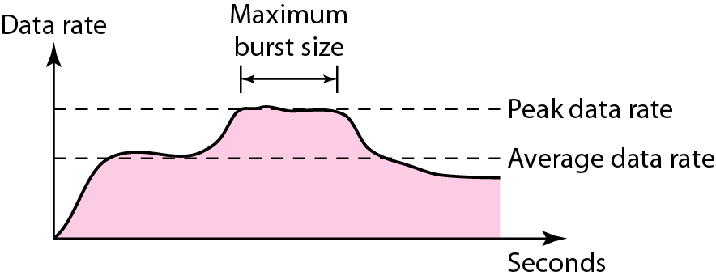
Figure 24.1 Traffic descriptors

Slide 6
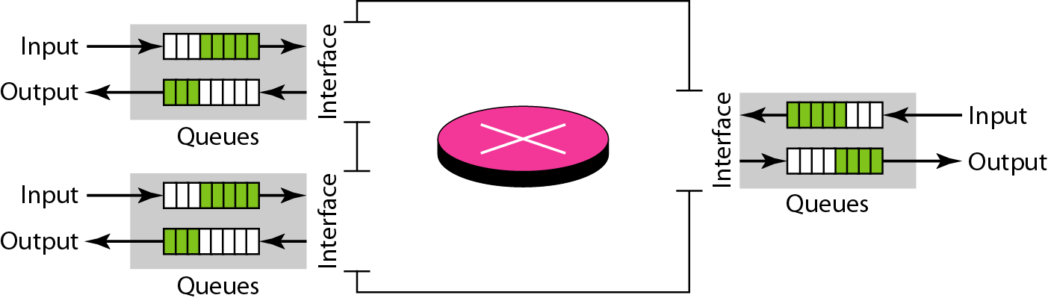
Figure 24.3 Queues in a router

Slide 7
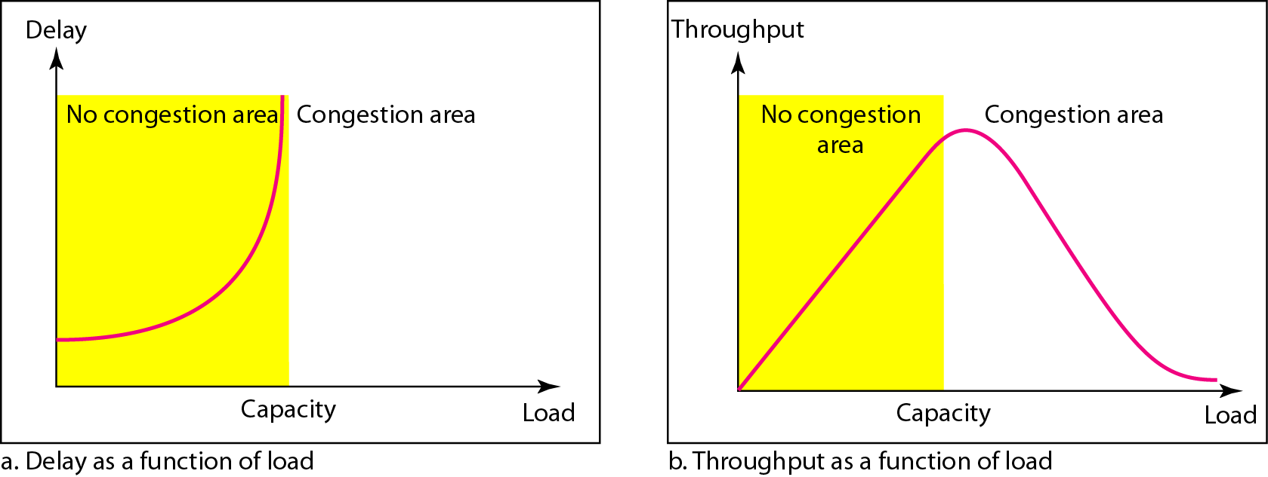
Network Performance: Delay and throughput as functions of load.

Slide 8
CONGESTION CONTROL
Congestion control refers to techniques and mechanisms that can either prevent congestion, before it happens or remove congestion after it has happened.
In general, we can divide congestion control mechanisms into two broad categories: open-loop congestion control (prevention) and closed-loop congestion control (removal).

Slide 9
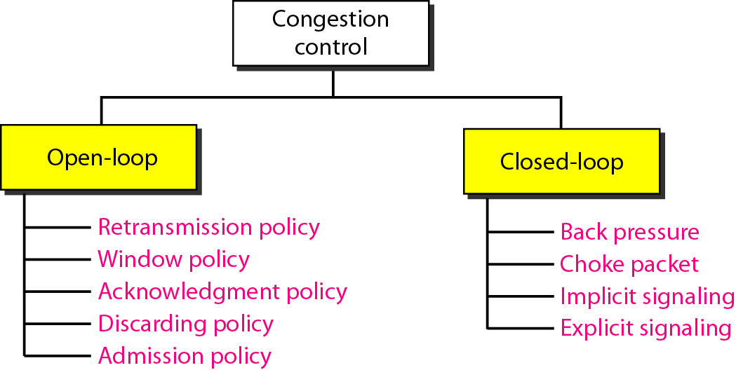
Congestion control categories

Slide 10
Congestion control categories.
In open loop congestion control, the sender simply transmits packets at a predetermined rate, without regard to the state of the network or the availability of network resources.
Retransmission Policy: -
It is the policy in which retransmission of the packets is taken care of. If the sender feels that a sent packet is lost or corrupted, the packet needs to be retransmitted. This transmission may increase the congestion in the network.
To prevent congestion, retransmission timers must be designed to prevent congestion and also able to optimize efficiency.

Slide 11
How to retransmit in retransmission policy?
When to retransmit
Lost Frame
Lost Ack
Damaged Frame
After Timer expiration
timer value too small– more retransmissions
timer value too large– delay in response to lost segment.

Slide 12
Window Policy
The type of window at the sender’s side may also affect the congestion. Several packets in the Go-back-n window are re-sent, although some packets may be received successfully at the receiver side. This duplication may increase the congestion in the network and make it worse.
Therefore, a Selective repeat window should be adopted as it sends the specific packet that may have been lost.
What will be the maximum size of the window- in case of sliding window protocol
Either you implement
- Go-Back N ARQ
- Selective Repeat ARQ

Slide 13
Discarding Policy -
A good discarding policy adopted by the routers is that the routers may prevent congestion and at the same time partially discard the corrupted or less sensitive packages and also be able to maintain the quality of a message.
In the case of audio file transmission, routers can discard less sensitive packets to prevent congestion and also maintain the quality of the audio file.

Slide 14
Acknowledgment Policy
Since acknowledgments are also part of the load in the network, the acknowledgment policy imposed by the receiver may also affect congestion. Several approaches can be used to prevent congestion related to acknowledgment.
The receiver should send an acknowledgment for N packets rather than sending an acknowledgment for a single packet. The receiver should send an acknowledgment only if it has to send a packet or a timer expires.

Slide 15
Admission Policy :
In admission policy, a mechanism should be used to prevent congestion. Switches in a flow should first check the resource requirement of a network flow before transmitting it further. If there is a chance of congestion or there is congestion in the network, the router should deny establishing a virtual network connection to prevent further congestion.

Slide 16
Closed Loop Congestion Control .
Closed-loop congestion control techniques are used to treat congestion after it happens. Several techniques are used by different protocols; some of them are: In the choke-packet method, the warning is from the router, which has encountered congestion, directly to the source station. The intermediate nodes through which the packet has traveled are not warned.
Backpressure is a node-to-node congestion control technique that propagates in the opposite direction of data flow.
The backpressure technique can be applied only to the virtual circuit where each node has information about its upstream node.

Slide 17
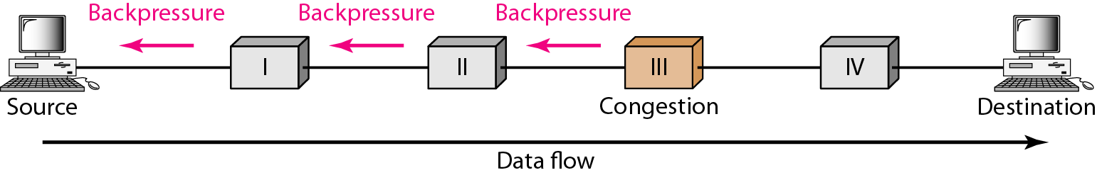
Back Pressure .

Slide 18
Choke packet.
A choke packet is a packet sent by a node to the source to inform it of congestion. Each router monitors its resources and the utilization at each of its output lines. Whenever the resource utilization exceeds the threshold value which is set by the administrator, the router directly sends a choke packet to the source giving it feedback to reduce the traffic.

Slide 19
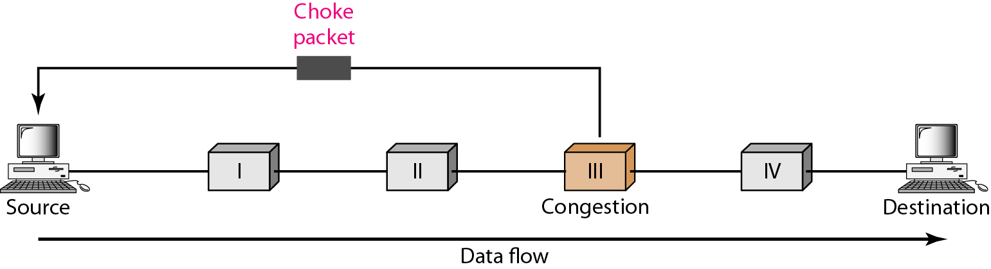
Choke Packet .

Slide 20
Implicit Signaling
3. In implicit signaling, there is no communication between the congested nodes and the source. The source guesses that there is congestion in a network. Implicit Signaling- by symptom source will be aware of congestion in the network. No communication is sent to the source from a congested node. For example, through delayed acknowledgments.
For example, when the sender sends several packets and there is no acknowledgment for a while, one assumption is that there is congestion.

Slide 21
Explicit signal-
Explicit signal- network alerts the sender or destination to slow down the rate of transmission by sending a signal that is included in the packet that carries data. That is why it’s different from a choke packet.
Backward signaling- warning source (opposite direction to congestion) and taking appropriate congestion corrective measures
Forward signaling- warning destination (same direction to congestion) and taking appropriate congestion avoidance measures. Such as receiver can slow down the acknowledgment

Slide 22
Quality of service (QoS)
To provide good quality service is to build a network with enough capacity for whatever traffic will be thrown at it. The name for this solution is over-provisioning.
Quality of service mechanisms let a network with less capacity meet application requirements just as well at a lower cost.

Slide 23
TECHNIQUES TO IMPROVE QoS.
Scheduling
FIFO Queuing
Priority Queuing
Weighted Fair Queuing
Traffic Shaping
Leaky Bucket
Token Bucket
Resource Reservation
Admission Control

Slide 24
TECHNIQUES TO IMPROVE QoS.
Some techniques that can be used to improve the quality of service. The four common methods are scheduling, traffic shaping, admission control, and resource reservation.
a. Scheduling
Packets from different flows arrive at a switch or router for processing. A good scheduling technique treats the different flows in a fair and appropriate manner. Several scheduling techniques are designed to improve the quality of service. We discuss three of them here: FIFO queuing, priority queuing, and weighted fair queuing.

Slide 25
FIFO Queuing.
In first-in, first-out (FIFO) queuing, packets wait in a buffer (queue) until the node (router or switch) is ready to process them.
If the average arrival rate is higher than the average processing rate, the queue will fill up and new packets will be discarded. A FIFO queue is familiar to those who have had to wait for a bus at a bus stop.

Slide 26
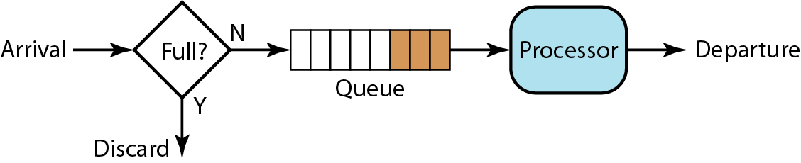
FIFO Queuing.

Slide 27
Priority Queuing .
In priority queuing, packets are first assigned to a priority class. Each priority class has its own queue. The packets in the highest-priority queue are processed first. Packets in the lowest-priority queue are processed last. Note that the system does not stop serving a queue until it is empty.
A priority queue can provide better QoS than the FIFO queue because higher priority traffic, such as multimedia, can reach the destination with less delay. However, there is a potential drawback. If there is a continuous flow in a high-priority queue, the packets in the lower-priority queues will never have a chance to be processed. This is a condition called starvation.

Slide 28
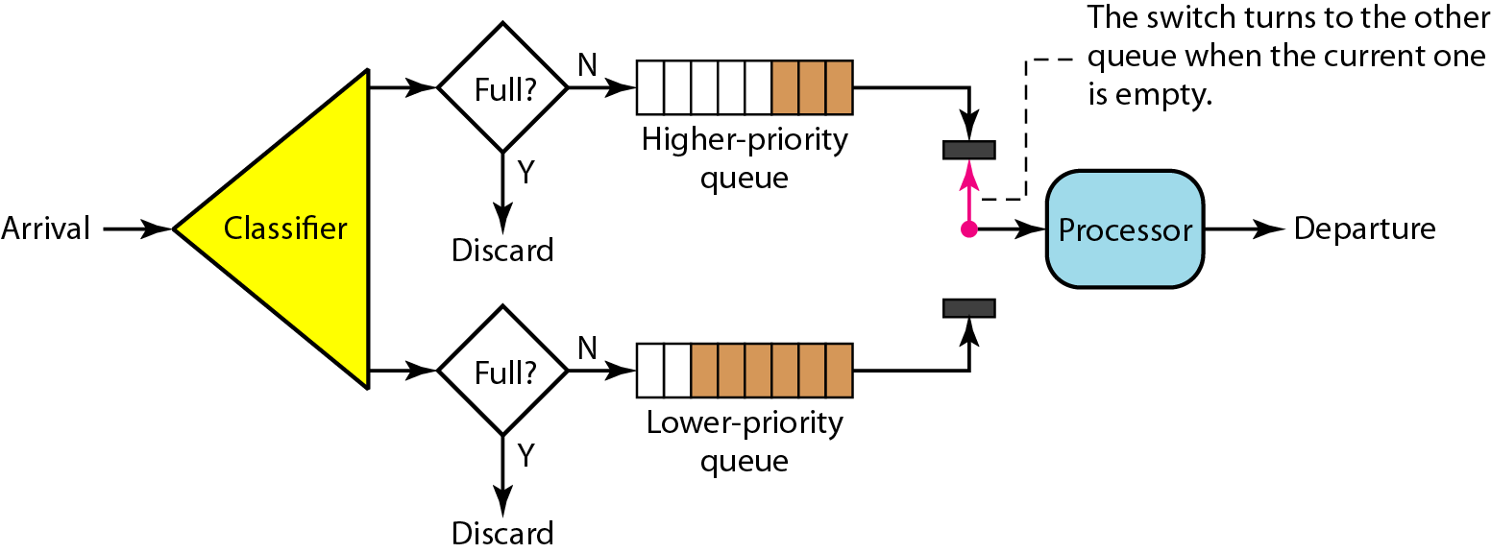
Priority Queuing.

Slide 29
Weighted Fair Queuing .
A better scheduling method is weighted fair queuing. In this technique, the packets are still assigned to different classes and admitted to different queues. The queues, however, are weighted based on the priority of the queues; higher priority means a higher weight. The system processes packets in each queue in a round-robin fashion with the number of packets selected from each queue based on the corresponding weight. For example, if the weights are 3, 2, and 1, three packets are processed from the first queue, two from the second queue, and one from the third queue. If the system does not impose priority on the classes, all weights can be equal. In this way, we have fair queuing with priority.

Slide 30
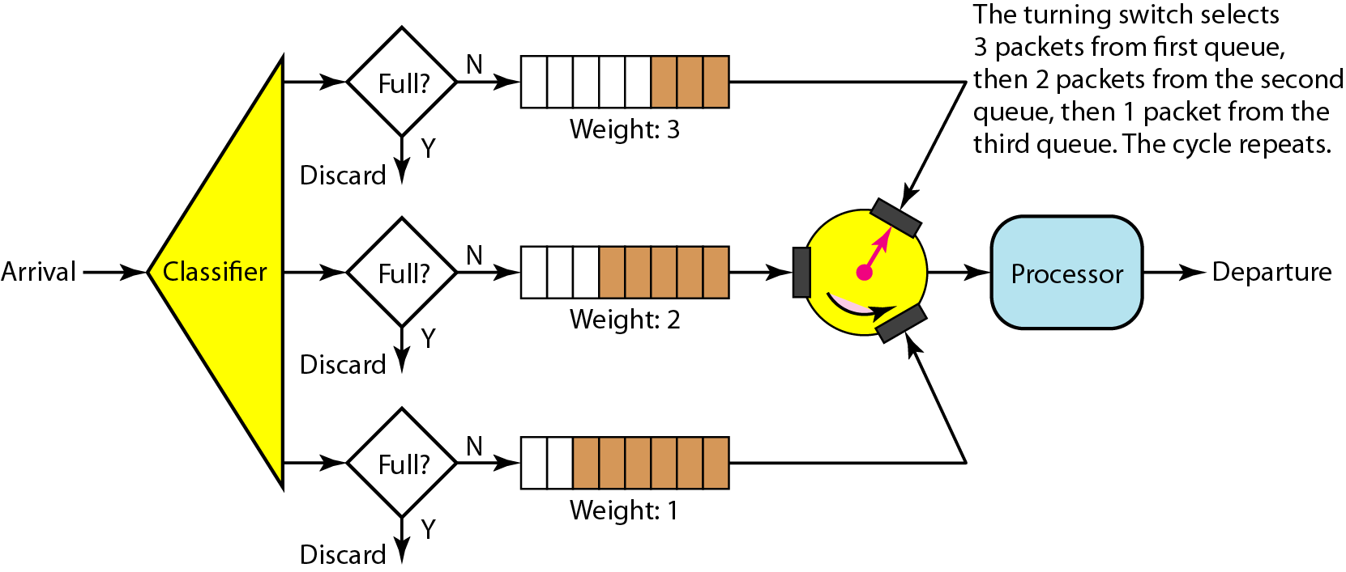

Slide 31
What is Traffic Shipping?
Traffic shaping is a technique for regulating/controlling the average rate and burst-ness of a flow of data that enters the network.
Traffic shaping is a mechanism to control the amount and the rate of traffic sent to the network. Two techniques can shape traffic: leaky bucket and token bucket .

Slide 32
Leaky Bucket.
If a bucket has a small hole at the bottom, the water leaks from the bucket at a constant rate as long as there is water in the bucket. The rate at which the water leaks does not depend on the rate at which the water is input to the bucket unless the bucket is empty. The input rate can vary, but the output rate remains constant. Similarly, in networking, a technique called leaky bucket can smooth out burst traffic. Bursty chunks are stored in the bucket and sent out at an average rate. Figure 4.34 shows a leaky bucket and its effects.

Slide 33
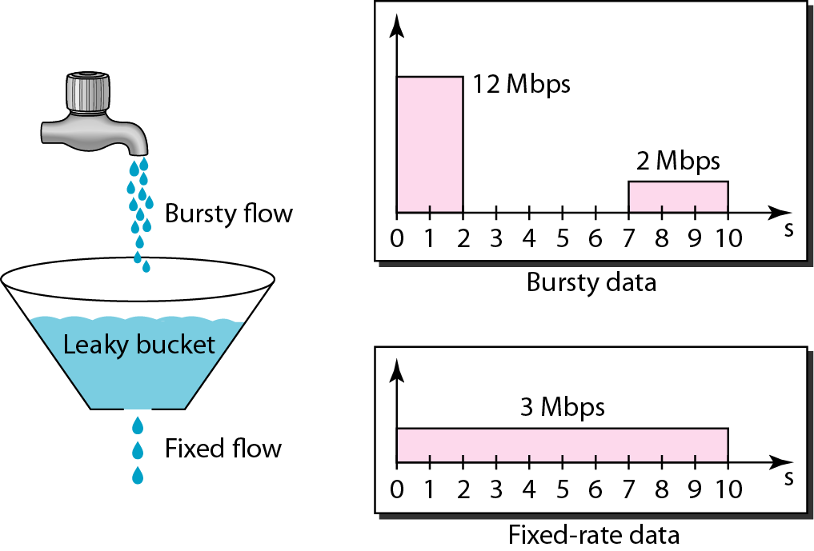

Slide 34
In the figure, we assume that the network has committed a bandwidth of 3 Mbps for a host. The use of the leaky bucket shapes the input traffic to make it conform to this commitment. In Figure 4.34 the host sends a burst of data at a rate of 12 Mbps for 2 s, for a total of 24 Mbits of data. The host is silent for 5 s and then sends data at a rate of 2 Mbps for 3 s, for a total of 6 Mbits of data. In all, the host has sent 30 Mbits of data in lOs. The leaky bucket smooths the traffic by sending out data at a rate of 3 Mbps during the same 10 s.

Slide 35
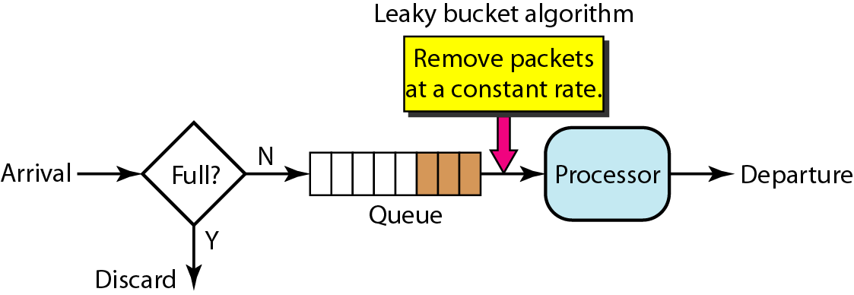

Slide 36
Token Bucket Algorithm.
The token bucket algorithm is one of the techniques for congestion control algorithms. When too many packets are present in the network it causes packet delay and loss of packet which degrades the performance of the system. This situation is called congestion.
Let us understand this algorithm step-wise as given below −
Step 1 − In regular intervals, tokens are thrown into the bucket f.
Step 2 − The bucket has a maximum capacity of f.
Step 3 − If the packet is ready, then a token is removed from the bucket, and the packet is sent.
Step 4 − Suppose, if there is no token in the bucket, the packet cannot be sent.

Slide 37
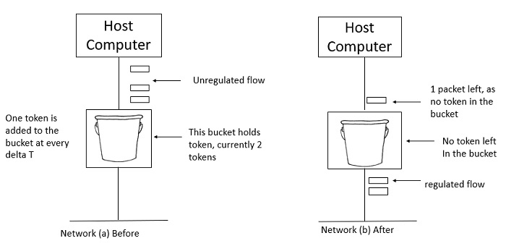
Example -Let us understand the Token Bucket Algorithm with an example −

Slide 38
In Figure (a) - the bucket holds two tokens, and three packets are waiting to be sent out of the interface.
In Figure (b) two packets have been sent out by consuming two tokens, and 1 packet is still left.
When compared to the Leaky bucket the token bucket algorithm is less restrictive which means it allows more traffic. The limit of busyness is restricted by the number of tokens available in the bucket at a particular instant of time.
The implementation of the token bucket algorithm is easy − a variable is used to count the tokens. For every t seconds, the counter is incremented and then it is decremented whenever a packet is sent. When the counter reaches zero, no further packet is sent out.

Slide 39
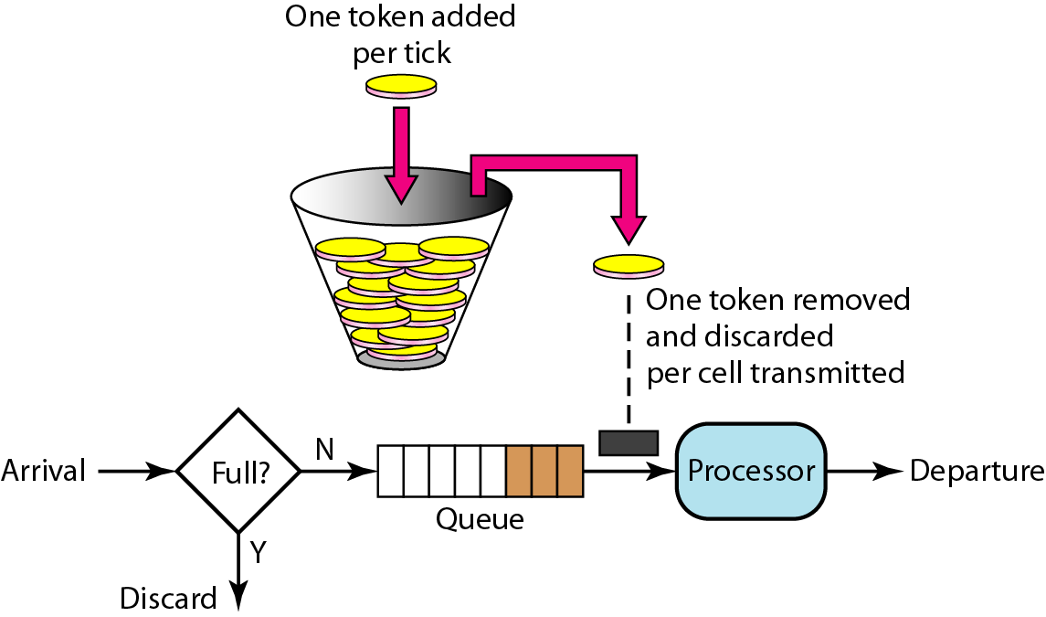
Figure 24.21 Token bucket

Slide 40
Resource Reservation .
A flow of data needs resources such as a buffer, bandwidth, CPU time, and so on. The quality of service is improved if these resources are reserved beforehand. We discuss in this section one QoS model called Integrated Services, which depends heavily on resource reservation to improve the quality of service.

Slide 41
Admission Control.
Admission control refers to the mechanism used by a router, or a switch, to accept or reject a flow based on predefined parameters called flow specifications. Before a router accepts a flow for processing, it checks the flow specifications to see if its capacity (in terms of bandwidth, buffer size, CPU speed, etc.) and its previous commitments to other flows can handle the new flow.

Slide 42


